Slide 1

Social Influence and Persuasion

Slide 2

Introduction
What Social Influence is
How Persuasion Works
How Compliance Works
How Obedience and Resistance Work

Slide 3
Social Influence
When one person (The Source) does something to get another person (The Target) to engage in a certain behaviour
Can result in Attitude Change
Can result in Compliance
Can result in both Attitude Change and Compliance – Case of Patty Hearst
Can result in neither

Slide 4


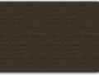
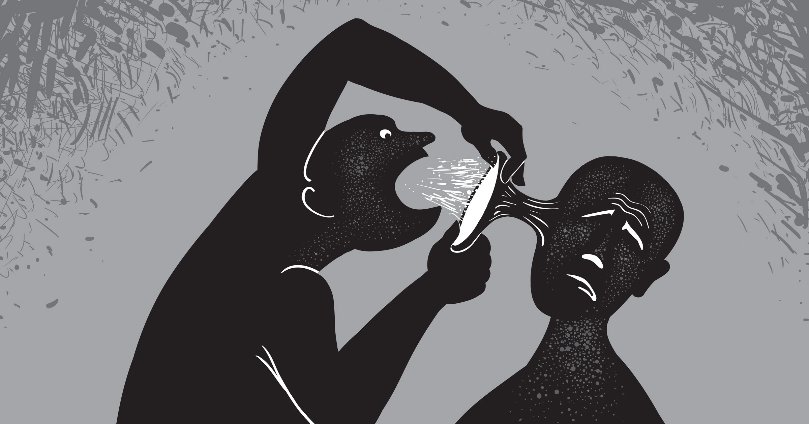
Persuasion
Persuasion is defined as “changing the beliefs, attitudes, or behaviours of a target through the use of information or an argument”

Slide 5
Communication-Persuasion Paradigm
The Source
The Message
The Target
The Response

Slide 6

The Source
The Credibility of the Source
Expert
Likeable
Attractive
Trustworthy
Hierarchy of Credibility
Scientists, Politicians, Activists, Celebrities

Slide 7
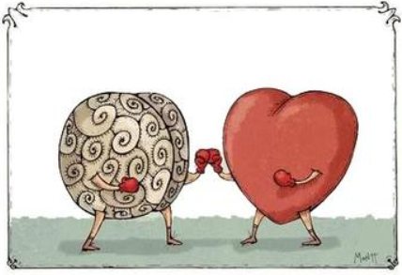
The Message
Can be based on Fact or Emotion
Discrepant Message
Relationship between the Credibility of the Source and Discrepancy of Message

Slide 8
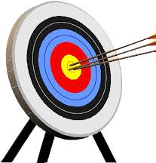
The Target
Factors that May Impact Whether the Target is Persuaded
Intelligence
Degree of Involvement
Personality
Degree of Focus/Distraction

Slide 9
Complying with Threats and Promises
‘Do as you are told!’
Compliance through Threat or Promise
Reward vs. Punishment
Magnitude and Credibility

Slide 10

Question
Think of the last time you obeyed someone or something (like a rule or law). Who or what were you obeying? What factors lead you to obey the authority?

Slide 11
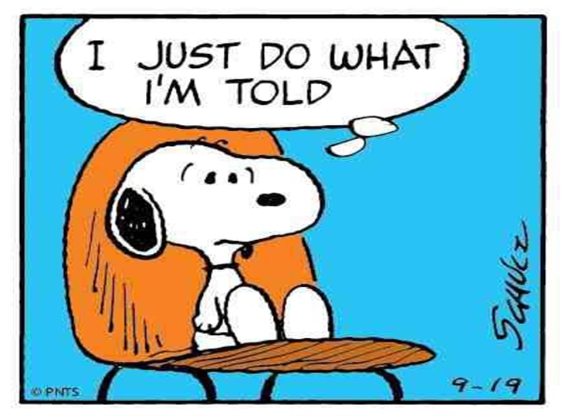
Obedience
Recognition of a Social System
Authority Figures

Slide 12
Authority
Authority must be accepted
“Civil order hinges on obedience…”
Milgram’s Experiment

Slide 13
Milgram’s Obedience Experiment
Created hierarchy in which one person (experimenter) directs another (subject) to engage in actions that hurt a third person (confederate)
Research subject instructed to shock the ‘learner’ (the confederate) when he gives an incorrect answer, with the ‘voltage’ increasing as the learner makes additional errors
Findings
65% continued to the end of the shock series (450 volts)
Not a single participant stopped prior to 300 volts
Many participants became distressed, pleaded with experimenter

Slide 14
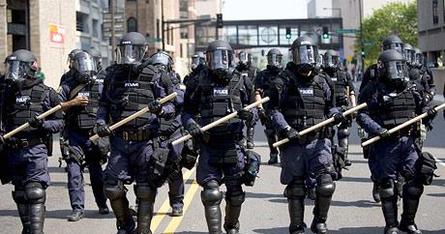
Factors that Impact Obedience
Outward sign of authority
Backing up threat of punishment
Where you are in the chain of command

Slide 15

Resistance
Not just Passive Actors

Slide 16
Forms of Resistance
Inoculation
Exposure to weak discrepant info as well as counterarguments supported by target
Forewarning
Warning target prior to act of persuasion
Reactance
‘Boomerang Effect’
When persuasion goes too far, Target reacts forcefully

Slide 17




Have a Great Day!

